Slide 1
Assessing Plant and Lichen Biodiversity Using Reflectance Spectra
Lance Stasinski

Slide 2
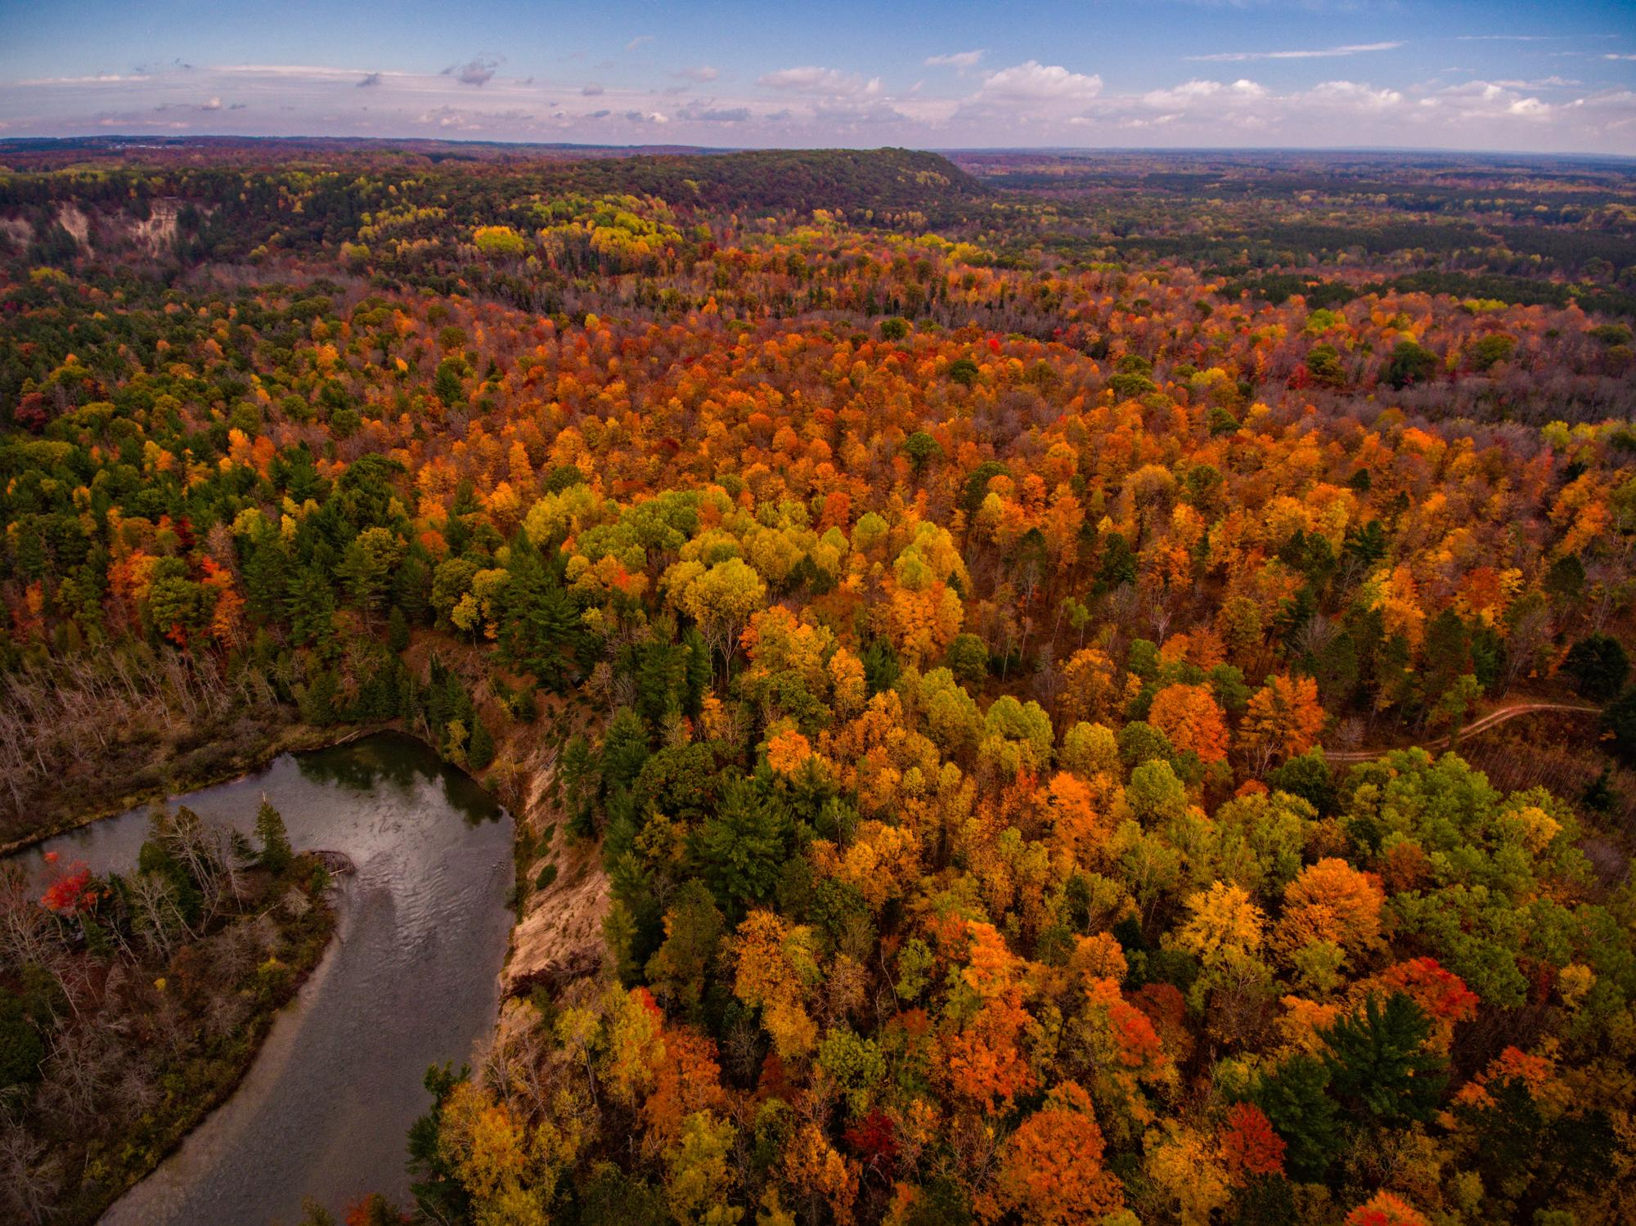

Carbon fixation
O₂
CO₂
Clean water
Nutrient cycling
Dennis Buchner
Notes:
Biodiversity corresponds to ecosystem function and ecosystem services that we rely on.

Slide 3
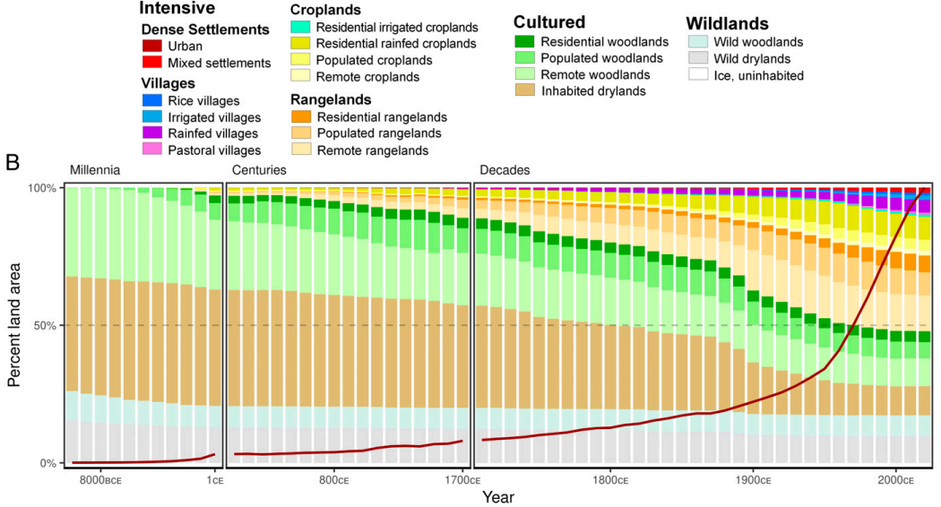
Ellis et al. (2021)
Notes:
Biodiversity is threatened from a variety of anthropogenic factors. Namely intensive land use has been increasing across time and the human population is sky rocketing. Demonstrates the need for conservation.

Slide 4
We need to detect and monitor biodiversity in order to conserve it

Slide 5




Solution?
Reflectance Spectroscopy!

Slide 6

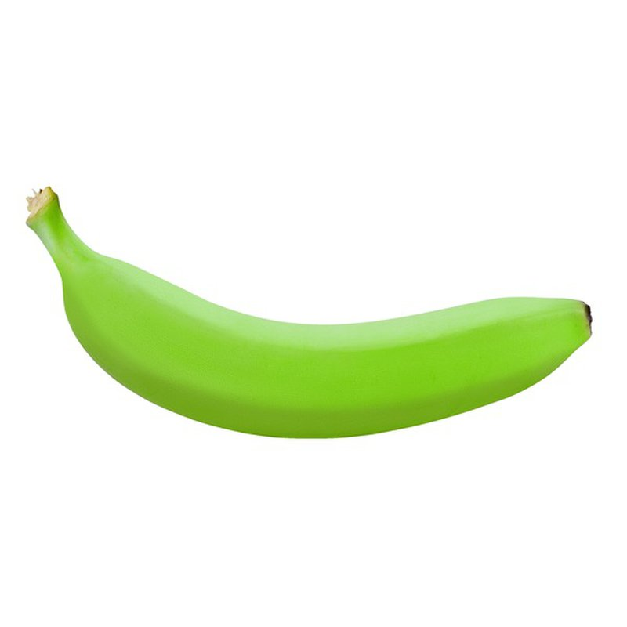
What is Reflectance Spectroscopy?
Notes:
3 sensors in our eyes yield helpful information, what if we had hundreds or thousands?

Slide 7
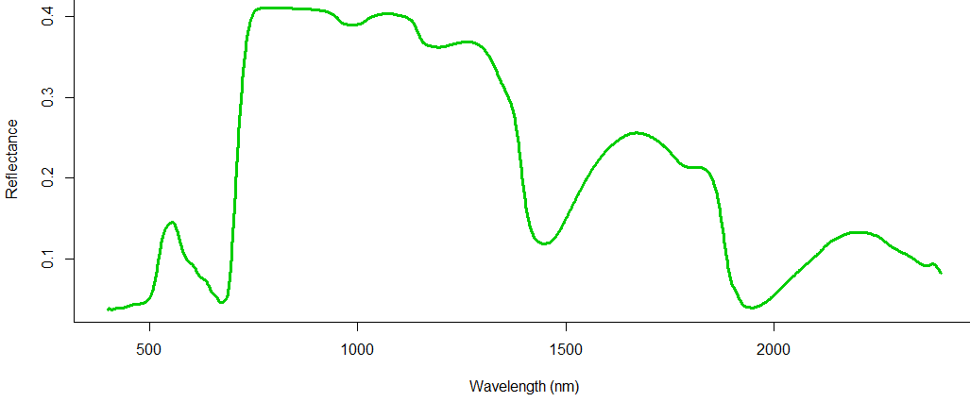
The Reflected Spectrum
Anatomy, Cellulose, Phenolic compounds
Pigments
Anatomy and Surface Features
Water

Slide 8
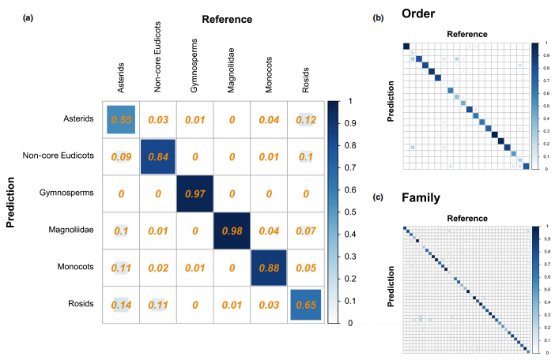
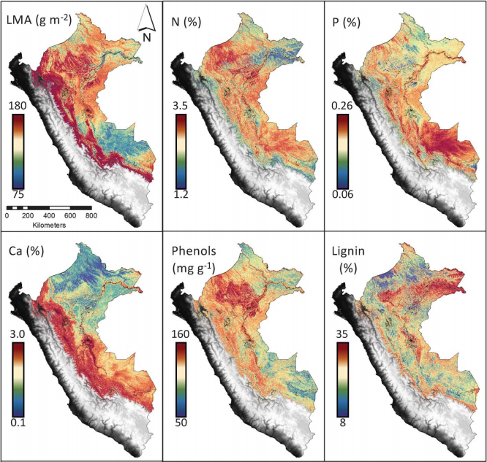
Spectroscopy is here to stay
Meireles et al. (2020)
Asner et al. (2017)
Notes:
Spectroscopy is incredibly powerful. We can distinguish taxanomic unite and estimate functional traits from light.

Slide 9


Roadblocks for spectroscopy
Not clear if we can detect fine-scale taxonomic diversity
Other taxa are poorly represented in spectral libraries
Plants
Lichens

Slide 10
Outline
Detecting fine-scale diversity
Chapter 1
Expanding lichen spectral libraries using herbarium specimens
Chapter 2

Slide 11
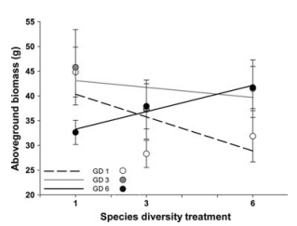
Fine-Scale Diversity – Diversity within Species and Species Complexes
Adaptive potential
Allows species/complexes to persist through change
Ecosystem processes
Productivity
Diversity at higher trophic levels
Hybridization
Adaptive potential
Transgression
a)
b)
Crawford and Rudgers (2012)
Notes:
Arthropod diversity increases with genetic diversity of plants. Transgression – hybrids more fit than parent taxa. Several reasons for wanting to detect fine-scale diversity.

Slide 12
Recently diverged species
Hybridization
A
A
B
Hybrid
C
B
D
Notes:
Are the phenotypes of recently diverged species different enough to be captured by spectra? Are the underlying traits of hybrids consistent enough to separate hybrids from parent species using spectra and multivariate models?

Slide 13
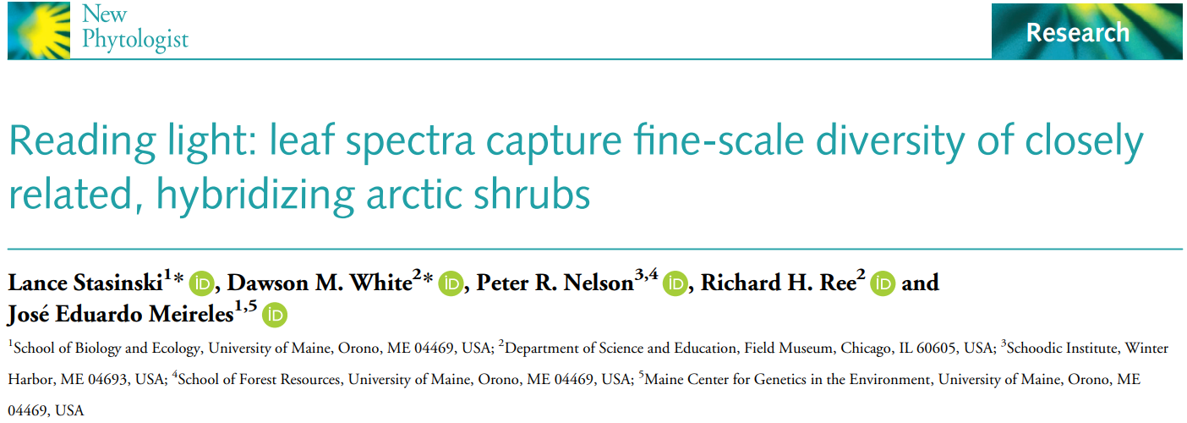
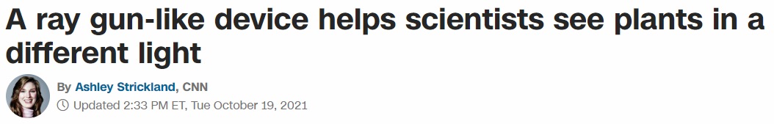

Slide 14
Collecting Dryas
Species
Dryas alaskensis
Alaskan endemic
Dryas ajanensis
Widespread, often confused with Dryas octopetala
Hybrids
Six sites
Data
DNA
Spectra

Slide 15
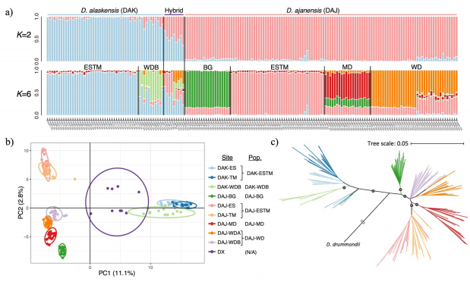
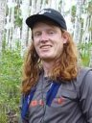
Six Populations Delimited
Genomic Data
Population delimitation
STRUCTURE
PCA

Slide 16
Species and Populations Predicted from Spectra
Methods
Partial Least Squares Discriminant Analysis (PLS-DA)
Prediction Species
With hybrids: 92.9% accuracy
Without hybrids: 99.7% accuracy
Predicting Populations
98.9% accuracy
Notes:
Discuss how populations are somewhat confounded with location – however that’s the nature of this system
Discuss hybrids and how they are predicted quite well despite inconsistent traits

Slide 17
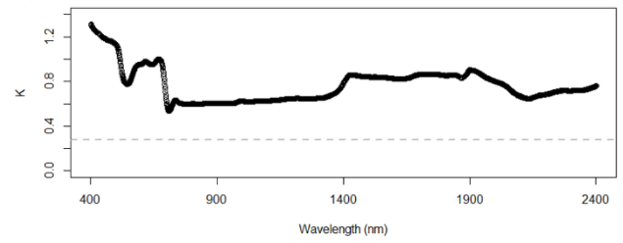
Ancestry Predicted from Spectra
Methods
PLS Beta Regression
Results
r-squared = 0.91
RMSE = 0.13
Significant phylogenetic signal for all wavelengths
Blomberg’s K = 0.4 to 1.3
p = 0.002
Notes:
The image is just one iteration and does not necessarily reflect the average. Points represent the mean prediction

Slide 18
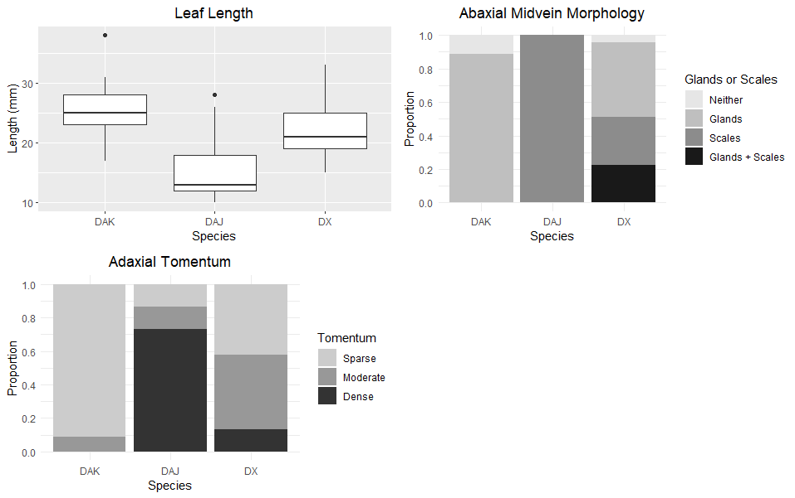
Hybrids
Did show higher trait variability than parent species
Still identified quite well (80% accuracy)

Slide 19
Fine-scale diversity is captured by spectra and should be considered going forward.
Conclusion
Notes:
We know the signal is there, so it’s just a matter of finding it in spectra acquired at larger scales

Slide 20
Outline
Detecting fine-scale diversity
Chapter 1
Expanding lichen spectral libraries using herbarium specimens
Chapter 2

Slide 21
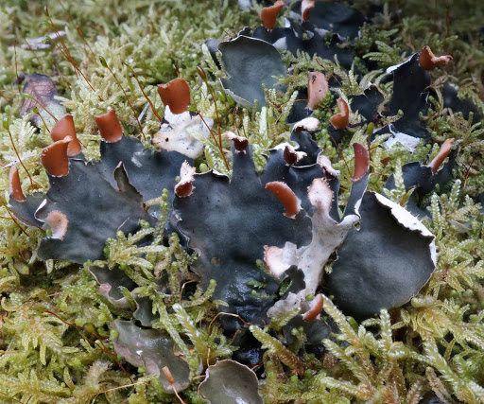
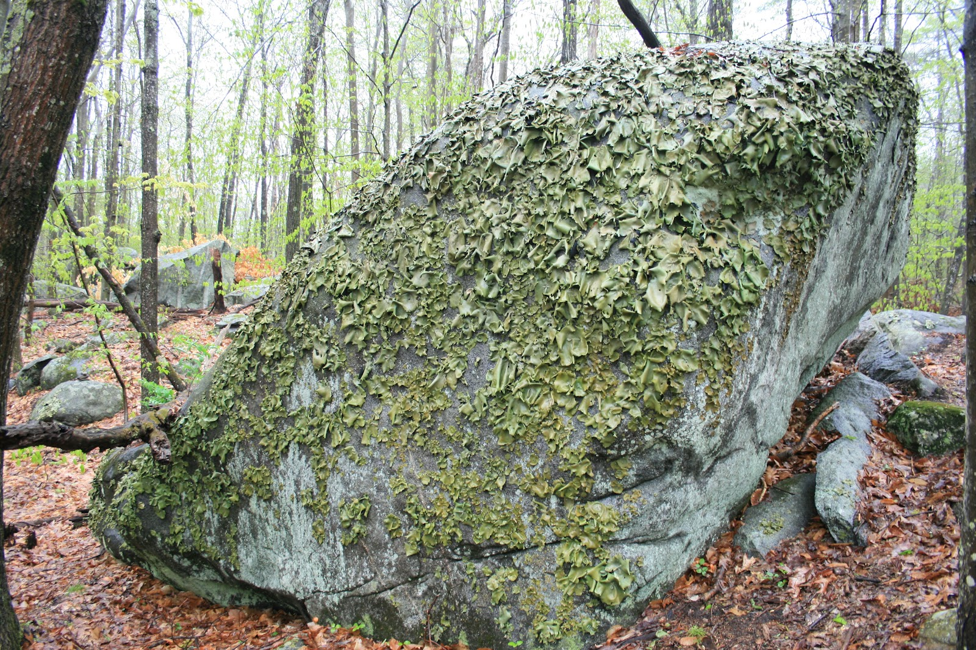
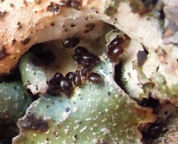
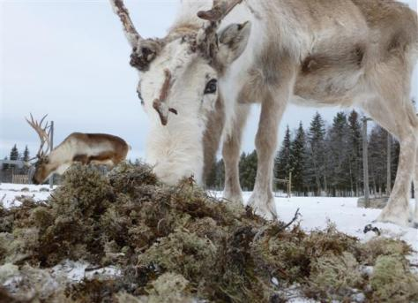
Why care about lichen?
Nitrogen fixation
Colonization
Habitat
Food source
Peltigera hymenia
Rock tripe
Oribatid mites on Parmelia saxatilis
Reindeer eating lichen
Notes:
Others: nutrient cycling, evolved several times so it must be a successful way of living that deserves attention

Slide 22

Lichens
Lichens

Slide 23
Why would we want to use herbarium specimens?
Already identified
Easy to setup a full scanning procedure
Key traits, such as chemistry, often recorded

Slide 24
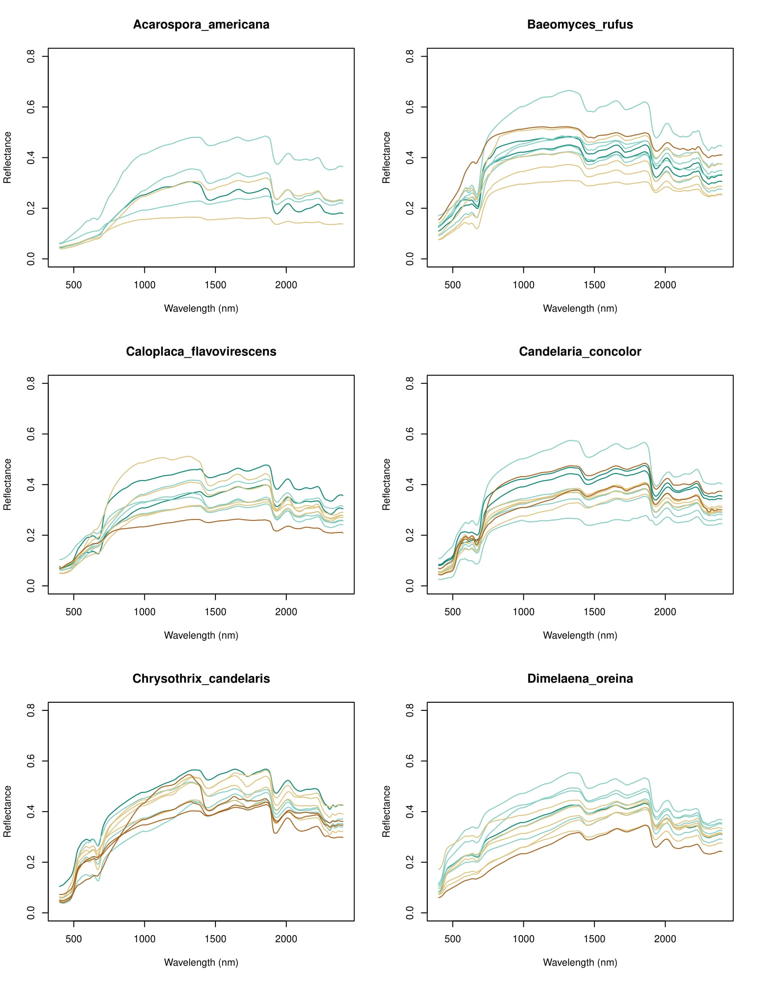
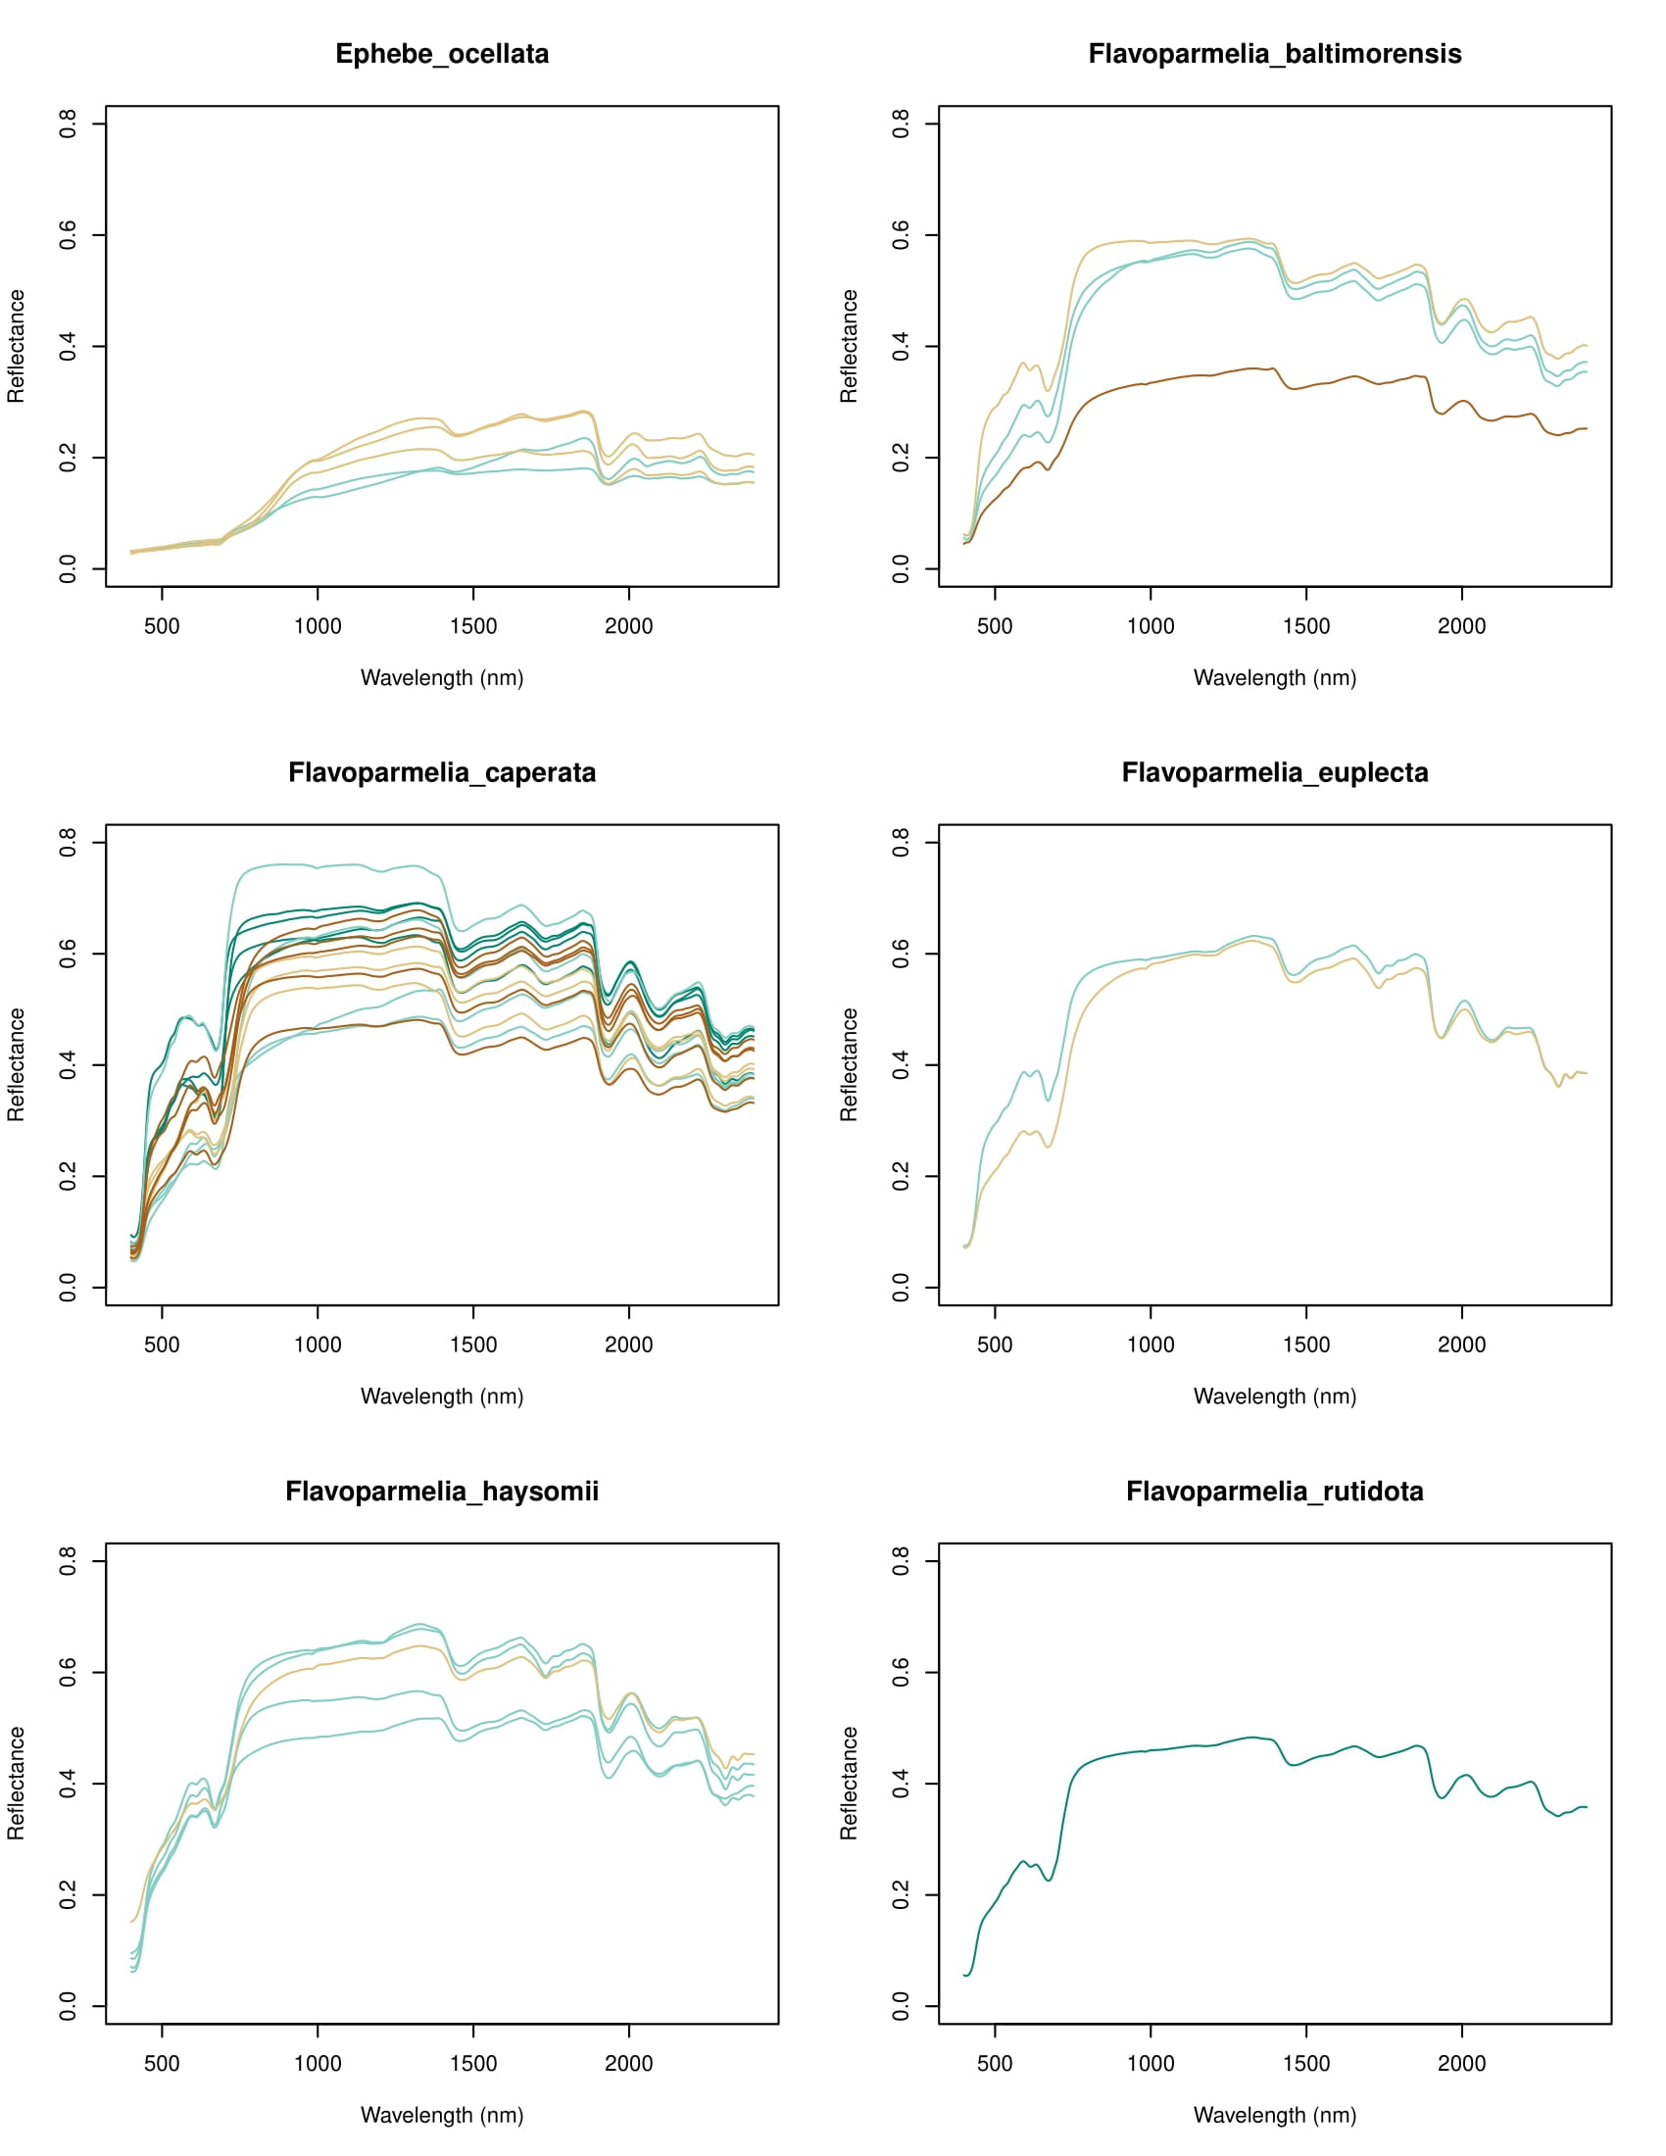
Applications
In the Herbarium
Identify unlabeled specimens
Catch misidentifications
Estimate historical diversity
Outside the herbarium
Build models to classify contemporary diversity
Can be used to assess spectral diversity of lichen

Slide 25

Unknowns
How do spectra of lichen change with age?
Can reflectance spectra of lichen herbarium specimens be used to classify taxa?
=

Slide 26
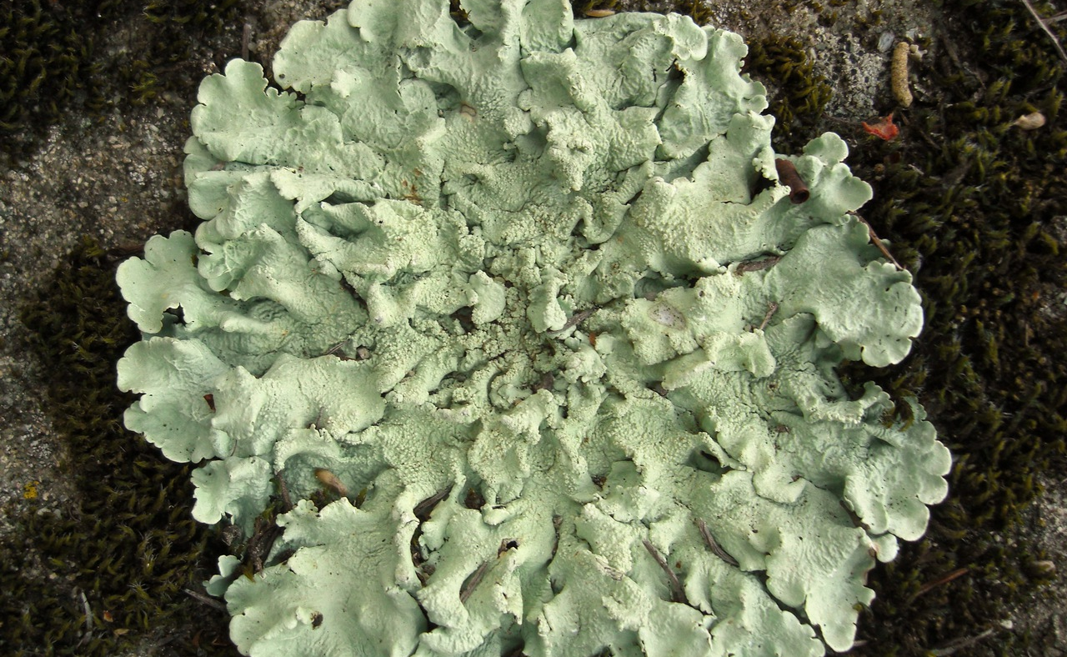
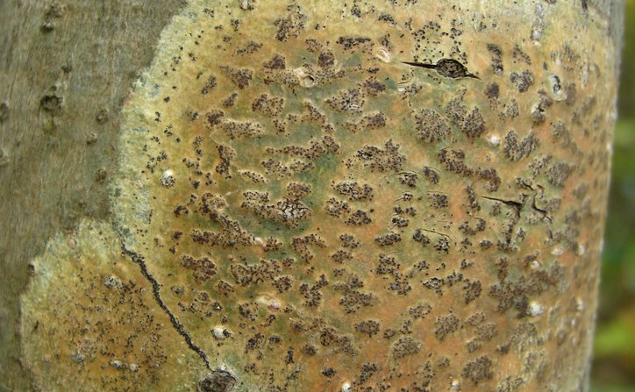
Complications
Hollinger (2011)
Diverse phylogeny: lichens evolved several times
Different desiccation tolerances
Diverse morphology and chemistry
Hollinger (2013)
Notes:
Desiccation tolerances vary based on typical habitat of the lichen species. A desert lichen handles desiccation much better than a lichen adapted for a moist forest environment. Diverse morphologies and chemistries may cause different patterns of change in the reflected spectrum.

Slide 27
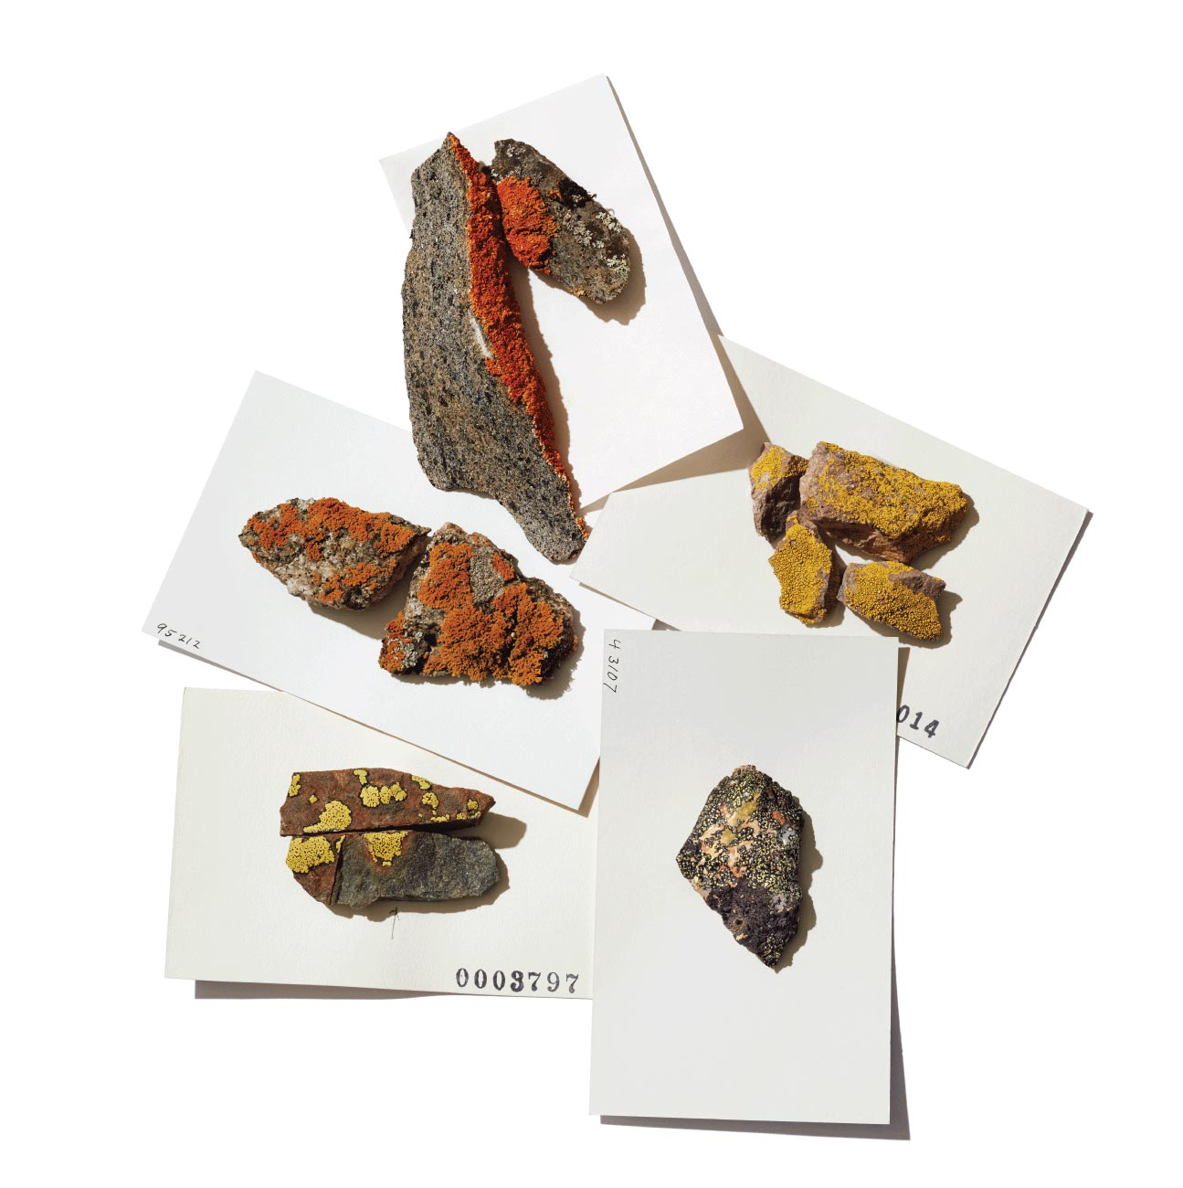
Herbarium specimens: A source for building spectral libraries for lichens
Bell Museum

Slide 28

Dataset
Taxonomy
30 species
19 families
16 orders
6 classes
From the Stanton lab at UMN
Notes:
This dataset does not look at any species in particular. Rather, it is intended to make a broad statement about lichen which are often incorrectly generalized by only a handful of species

Slide 29
How do spectra change with age?

Slide 30
Three models
Intercept only – no effect of age
Fixed slope – intercepts were allowed to vary between species
Variable slope – slope and intercepts were allowed to vary between species

Slide 31
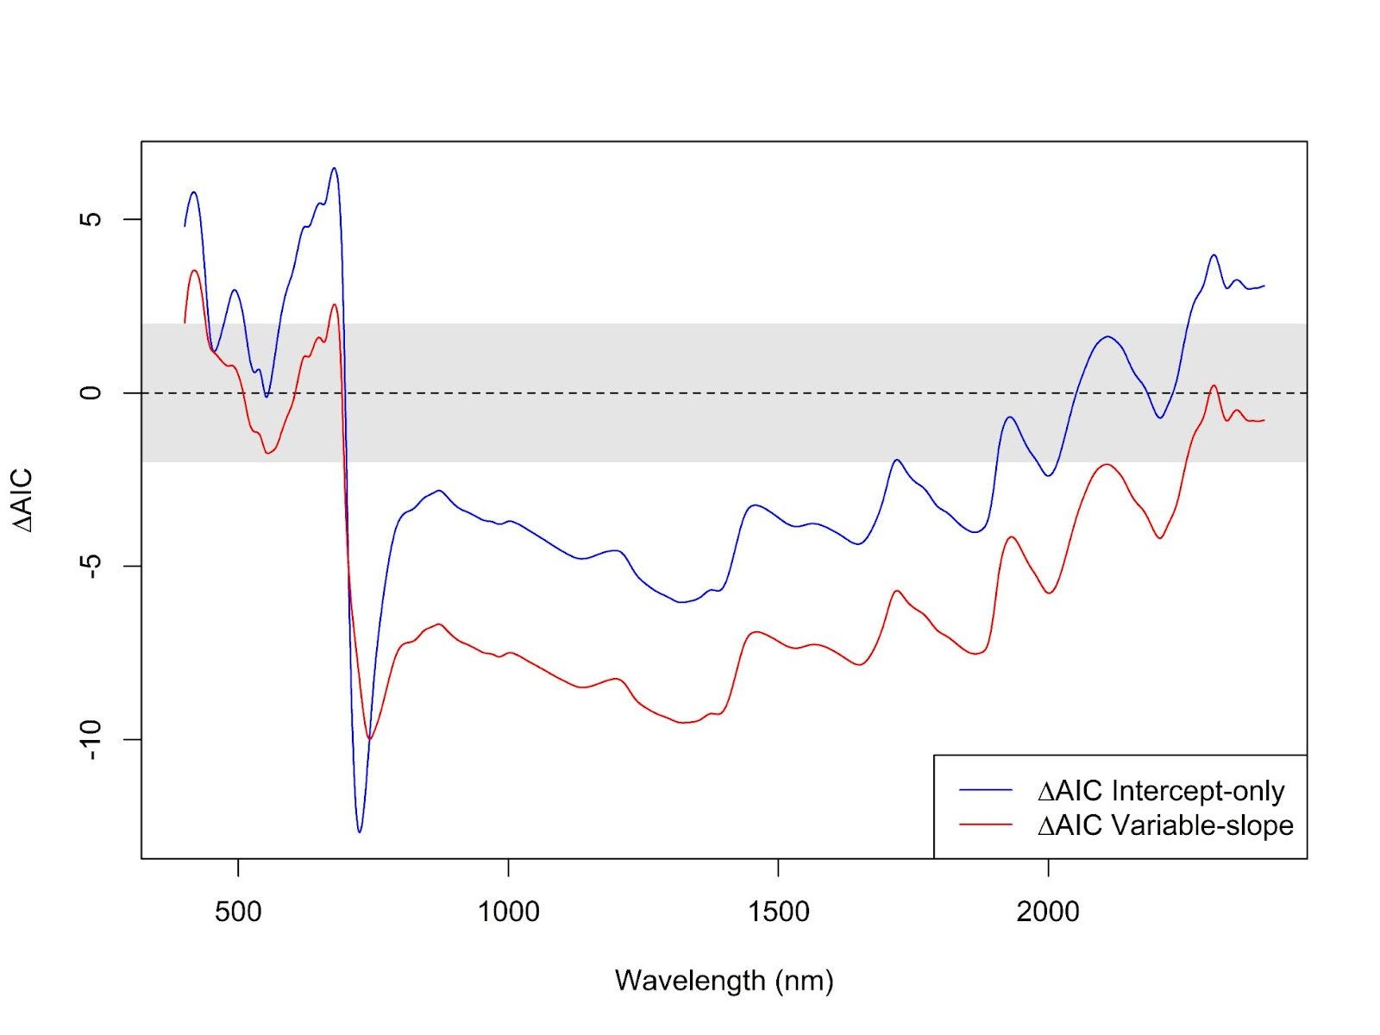
Different species change at about the same rate
Fixed-slope model vs Intercept-only and variable-slope models
Notes:
Mention that only the first 60 years of data were used for these lmm analyses.

Slide 32
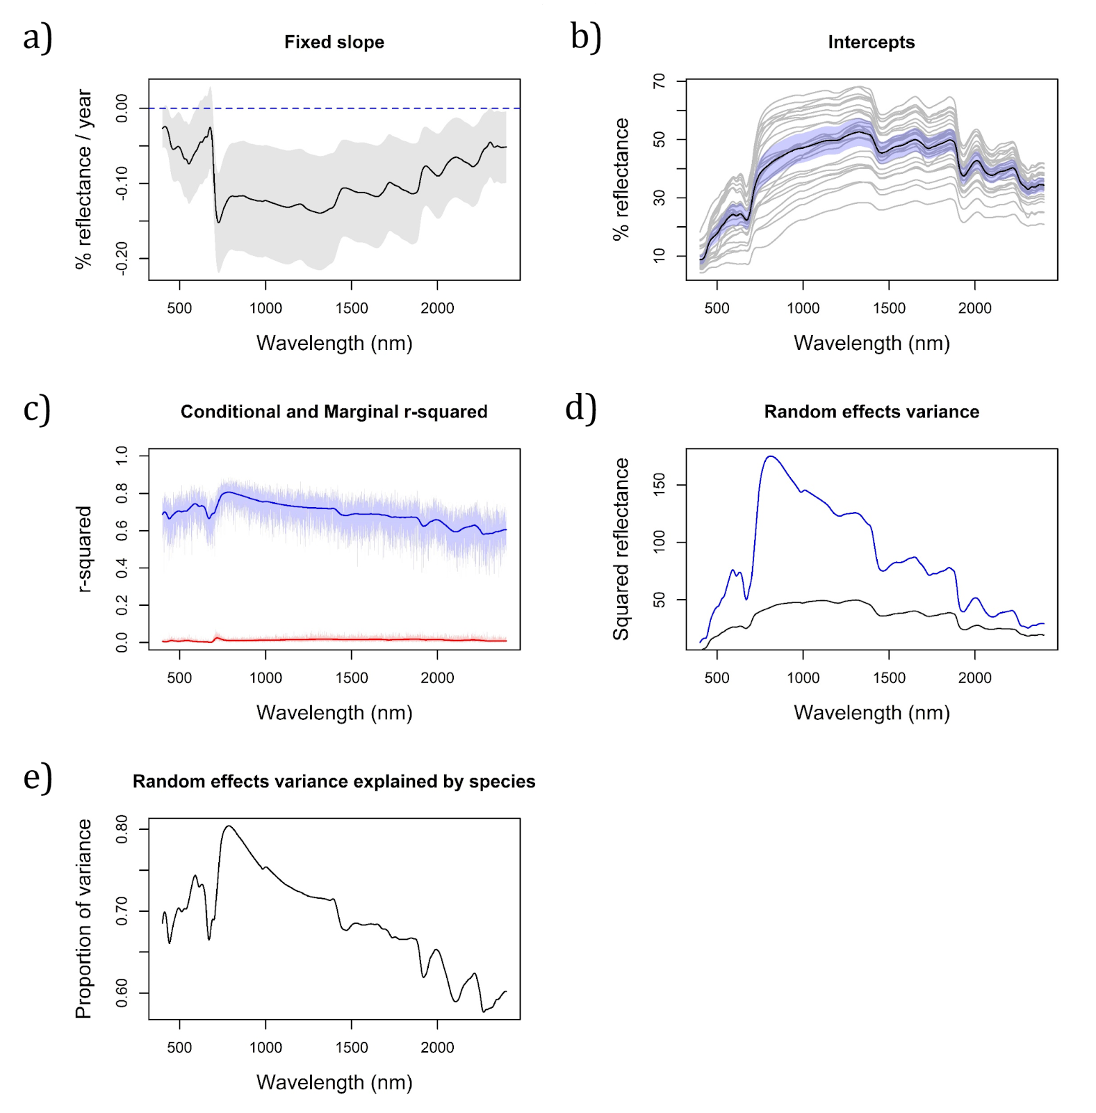
Decrease in reflectance
Conditional r-squared between 0.6 and 0.8
Most of the variation explained by the differences in intercepts between species
Notes:
Decrease in NIR and SWIR, yet only less than 0.2% per year. Different intercepts between species explained most of the variation.

Slide 33
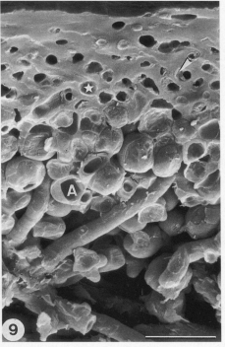
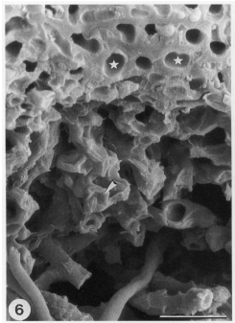
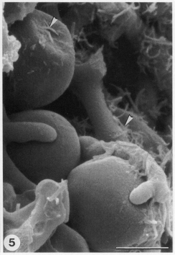
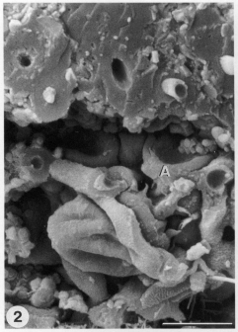
Changes in the NIR/SWIR
Decomposition
Microbes
Cavitation
Scheidegger et al. (1995)
Notes:
Hyphae: moist – swollen hyphae, dry – cavitated hyphae
Algae: moist – round cells, dry – heavily cavitated

Slide 34
Lack of change in the VIS
1. Changes in the VIS occur before the time interval presented here
2. Changes in thallus structure may change how light interacts with pigments
3. Secondary compounds counteract or mask expected changes
Chlorophyll
Time
Notes:
Explain expected change: increase in blue and red wavelengths since chl. Absorbs red and blue.

Slide 35
Can we classify taxa from spectra of herbarium specimens?

Slide 36
2 PLS-DA Model Types
1. Taxon ID ~ spectra
2. Taxon ID ~ spectra + age

Slide 37
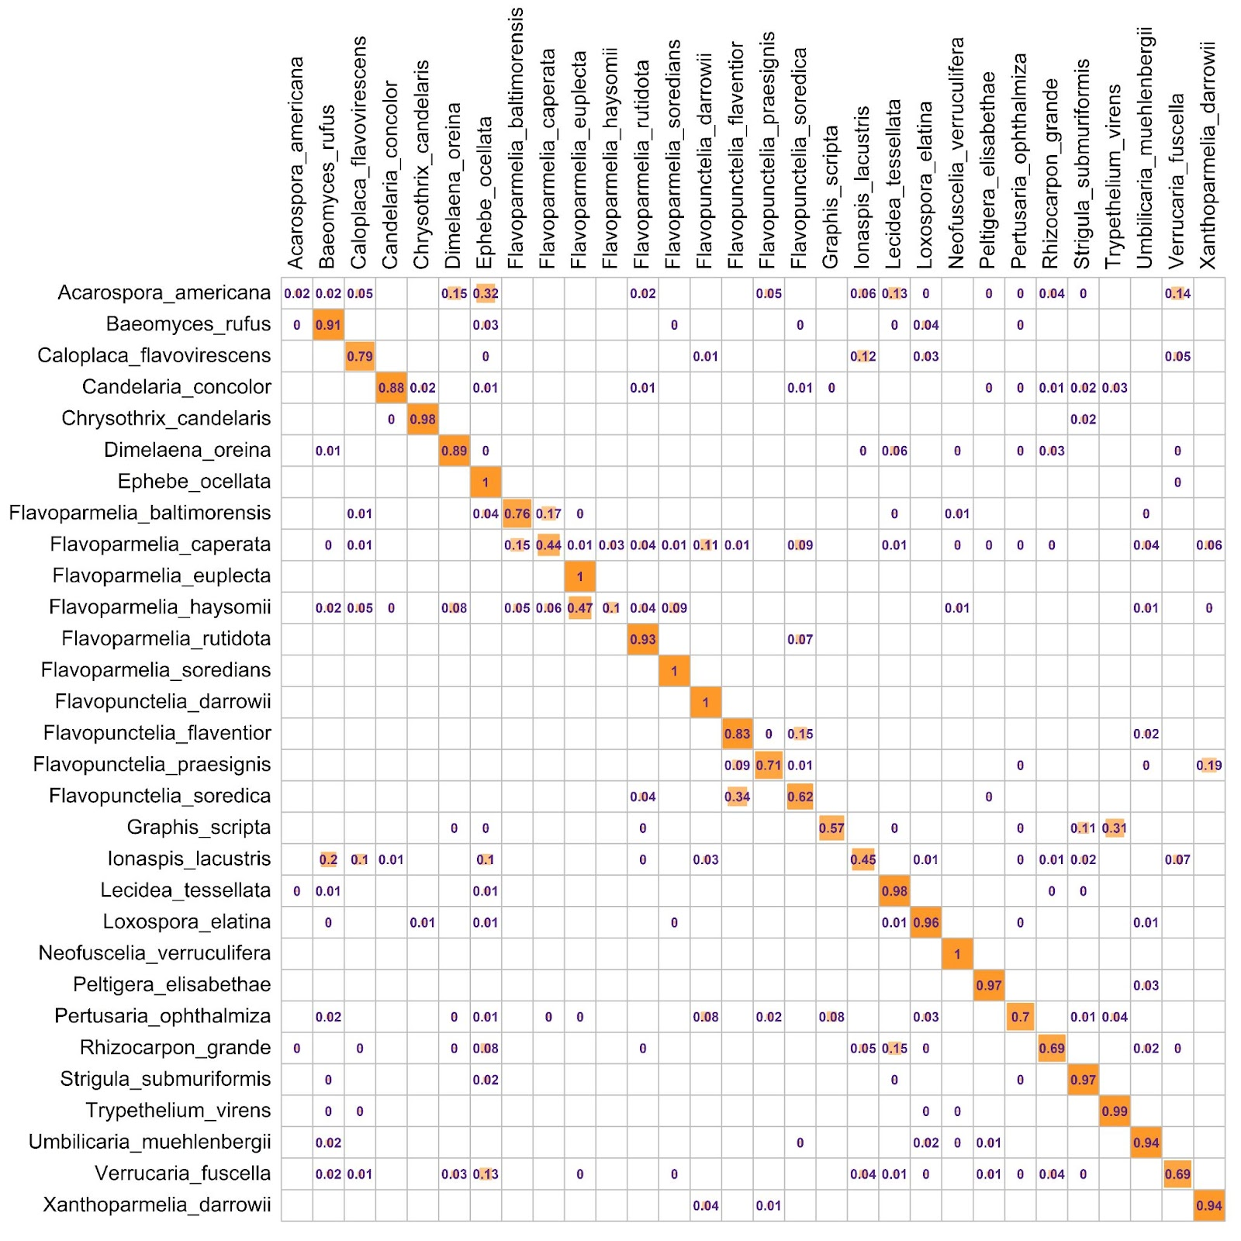
Species classified well
77.0 % overall accuracy

Slide 38
Aging does influence classification, but not by much
Taxonomic rank | Difference of means (%) | Standard Error | t | p-value
Species | 3.54 | 0.28 | -13.9 | 2.2E-16 *
Family | -0.07 | 0.16 | 0.43 | 0.668
Order | 0.49 | 0.19 | -2.59 | 0.010 *
Class | 1.40 | 0.29 | -4.77 | 3.52E-06 *
Difference of means: Accuracy with age minus accuracy without age
* P ≤ 0.01

Slide 39
Herbarium specimens are a suitable source for building a spectral library for lichens despite a slight effect of age.
Conclusion
Notes:
We know the signal is there, so it’s just a matter of finding it in spectra acquired at larger scales

Slide 40

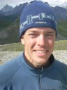

Acknowledgements
Dawson M. White
Field Museum
Dudu Meireles
University of Maine
Peter R. Nelson
Schoodic Institute
Richard H. Ree
Field Museum
Daniel Stanton
University of Minnesota
Laura Williams and Shan Kothari – friendly review of the Dryas manuscript
Catherine Chan and Kevaughan Smith – data collection
Brian McGill - Advice about MANOVA and LMMs
Jacquelyn Gill – Conceptual advice and bureaucratic navigation

Slide 41
Questions?

Slide 42
Articles
Asner, G. P., R. E. Martin, D. E. Knapp, R. Tupayachi, C. B. Anderson, F. Sinca, N. R. Vaughn, and W. Llactayo. 2017. “Airborne Laser-Guided Imaging Spectroscopy to Map Forest Trait Diversity and Guide Conservation.” Science 355 (6323): 385–89.
Crawford, Kerri M., and Jennifer A. Rudgers. 2012. “Plant Species Diversity and Genetic Diversity within a Dominant Species Interactively Affect Plant Community Biomass.” Edited by James Cahill. The Journal of Ecology 100 (6): 1512–21.
———. 2013. “Genetic Diversity within a Dominant Plant Outweighs Plant Species Diversity in Structuring an Arthropod Community.” Ecology 94 (5): 1025–35.
Ellis, Erle C., Nicolas Gauthier, Kees Klein Goldewijk, Rebecca Bliege Bird, Nicole Boivin, Sandra Díaz, Dorian Q. Fuller, et al. 2021. “People Have Shaped Most of Terrestrial Nature for at Least 12,000 Years.” Proceedings of the National Academy of Sciences of the United States of America 118 (17). https://doi.org/10.1073/pnas.2023483118.
Meireles, José Eduardo, Jeannine Cavender-Bares, Philip A. Townsend, Susan Ustin, John A. Gamon, Anna K. Schweiger, Michael E. Schaepman, et al. 2020. “Leaf Reflectance Spectra Capture the Evolutionary History of Seed Plants.” The New Phytologist, June. https://doi.org/10.1111/nph.16771.
Scheidegger C, Schroeter B, Frey B. 1995. Structural and functional processes during water vapour uptake and desiccation in selected lichens with green algal photobionts. Planta 197: 399–409.

Slide 43
Photos
Bell Museum (n.d.) Lichen herbarium specimens [digital image]. Retrieved from https://www.bellmuseum.umn.edu/fungi/
Buchner, D. (n.d.) Mixed broadleaf forest [digital image]. Retrieved from: https://unsplash.com/photos/eDdimQeSW5c
CNX OpenStax (2016). Lichen Diagram [digital image]. Retrieved from https://commons.wikimedia.org/wiki/File:OSC_Microbio_05_05_lichenstr.jpg
Hollinger, Jason. (2011). Flavoparmelia caperata [digital image]. Retrieved from https://mushroomobserver.org/image/show_image/240112
Hollinger, Jason (2013). Trypethelium virens [digital image]. Retrieved from https://www.waysofenlichenment.net/lichens/Trypethelium%20virens
Instacart (n.d.) Green Banana [digital image]. Retrieved from https://www.instacart.com/products/16702340-green-banana-each
Oribatid mites on Parmelia saxatilis [digital image]. Retrieved from: http://www.lichens.lastdragon.org/faq/glossary2.html
Peltigera hymenia [digital image]. Retrieved from: https://lh3.googleusercontent.com/proxy/GCxzuUMgASC86sL32J05s2p1eHFhzUtYRBslhXHWpuz75LJUrOEiI7-nUSX7Yh-4yNxOYz-pAMSiiH4v1mKPwJTNkeyOW_Mtim3-WBf69vO4mYJKLO_NgTFXOUh8Q1Q
Reindeer eating lichen [digital image]. Retrieved from: https://sciencetechnologyandhealth.files.wordpress.com/2015/11/reindeer-eating-lichen-small.jpg?w=474
Rock tripe [digital image]. Retrieved from: https://easternplant.blog/2015/02/02/rock-tripe-come-see-incredible-colonies/
White, D.M. (2019). Dryas ajanensis [digital image].

Slide 44
Extras

Slide 45
Family

Slide 46
Order

Slide 47
Class

Slide 48
Species + age

